Slide 1
Chapter 3 Project Management
CIS 315
Stefan Bund, MS
Cal Poly Pomona

Slide 2
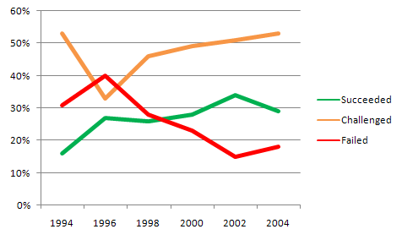
IT project failure rate
Source: The Standish Group 2006 Chaos Report
IT project failure from different sources
http://www.it-cortex.com/Stat_Failure_Rate.htm
Notes:
Source: The Standish Group 2006 Chaos Report

Slide 3
Recent Significant IT Failures
Company | Year | Outcome
Hudson Bay (Canada) | 2005 | Inventory system problems lead to $33.3 million loss.
UK Inland Revenue | 2004/5 | $3.45 billion tax-credit overpayment caused by software errors.
Avis Europe PLC (UK) | 2004 | Enterprise resource planning (ERP) system cancelled after $54.5 million spent.
Ford Motor Co. | 2004 | Purchasing system abandoned after deployment costing approximately $400 M
Hewlett-Packard Co. | 2004 | ERP system problems contribute to $160 million loss.
AT&T Wireless | 2004 | Customer relations management system upgrade problems lead to $100M loss
Source: Charette, Robert N., “Why Software Fails,” IEEE Spectrum Online, Sept. 2005.
Notes:
Source: Charette, Robert N., “Why Software Fails,” IEEE Spectrum Online, Sept. 2005.

Slide 4
Why Software Development Projects Fail?
Projects fail because:

Slide 5
Project Management
Project management is the process of planning and controlling the development of a system within a specified time frame at a minimum cost with the right functionality.
Four steps in project management
Identifying the project size;
Creating and managing the workplan;
Staffing the project;
Coordinating project activities.
Recommend: Project Management Certificate from PM Institute (pmi.org)

Slide 6
Step 1. Identifying Project Size

Slide 7
Cost-Schedule-Performance Trade-offs
Cost
Project management involves balancing trade-offs among the three key project parameters
Project
Schedule
Performance
What if the deadline is shortened?
Solution: to decrease the size of the system (by eliminating some of its functions) or to increase costs or by adding more people or having them work overtime.

Slide 8
Estimating Project Timeframes

Slide 9
Step 2. Creating and Managing the Work plan

Slide 10
Developing Work Plans

Slide 11
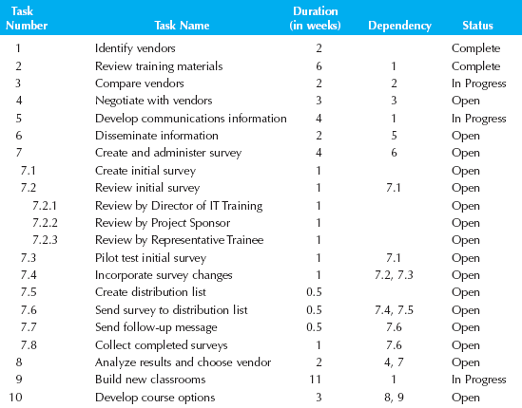
Work Breakdown Structure

Slide 12
Graphical Work Plans

Slide 13
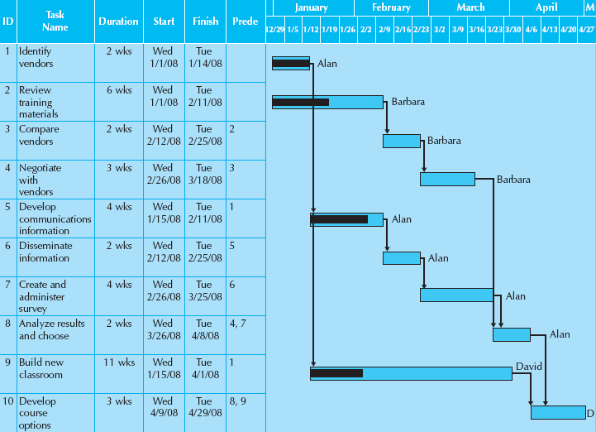
Gantt Chart

Slide 14
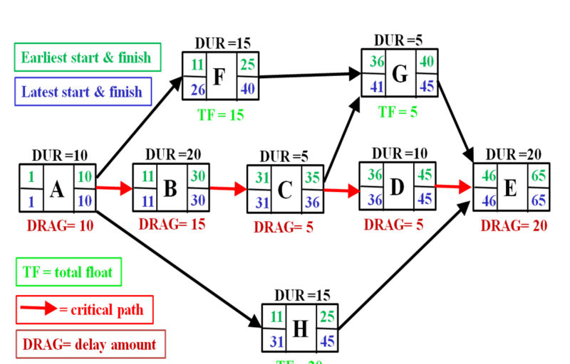
Critical Path Method (CPM)
The critical path is the longest path from the project inception to completion.
A list of all activities required to complete the project (typically categorized within a work breakdown structure),
The time (duration) that each activity will take to complete,
The dependencies between the activities and,
Logical end points such as milestones or deliverable items.

Slide 15
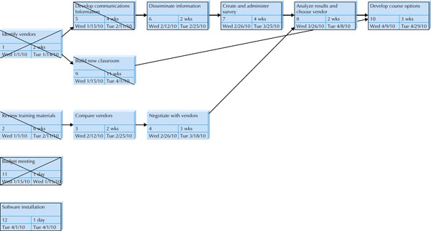
Program Evaluation and Review Technique (PERT)
Optimistic time (O): the minimum possible time required to accomplish a task, assuming everything proceeds better than is normally expected
Pessimistic time (P): the maximum possible time required to accomplish a task, assuming everything goes wrong (but excluding major catastrophes).
Most likely time (M): the best estimate of the time required to accomplish a task, assuming everything proceeds as normal.
Expected time (TE): the best estimate of the time required to accomplish a task, accounting for the fact that things don't always proceed as normal.
TE = (O + 4M + P) ÷ 6

Slide 16
Scope Management

Slide 17
Step 3. Staffing the Project

Slide 18
Reporting Structures
Typically, a project has one project manager.
To keep the communication effective, team size is usually less than 8-10 people.
Question: What if the skills of the available project team members do not match what is actually required by the project?

Slide 19
Staffing the Project

Slide 20
Step 4. Coordinating Project Activities

Slide 21
Standards
What needs standards in an IT project?
Types of Standards | Example
Documentation standards | The date and project name should appear as a header on all documentation.
Coding standards | All modules of code should include a header that lists the programmer, last date of update, and a short description of the purpose of the code.
Procedural standards | Report to project update meeting on Fridays at 3:30 PM. All changes to a requirements document must be approved by the project manager.
Specification requirement standards | Name of program to be created Description of the program’s purpose
User interface design standards | The tab order of the screen will move from top left to bottom right. Accelerator keys will be provided for all updatable fields.

Slide 22
Managing Risk
Project team creates a risk assessment that tracks potential risks along with an evaluation of the likelihood of each risk and potential impact on the project.

